Slide 1
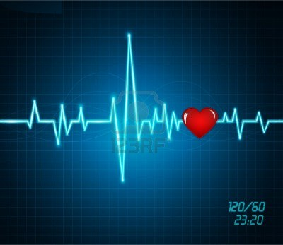
Be the Beat Hands Only CPR

Slide 2
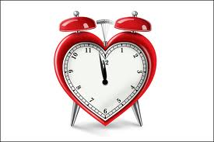
Why Learn CPR
If an adult has a sudden cardiac arrest (SCA), survival depends greatly on immediately getting CPR.
4-6 minutes after experiencing symptoms of cardiac arrest chances of brain damage are possible.

Slide 3
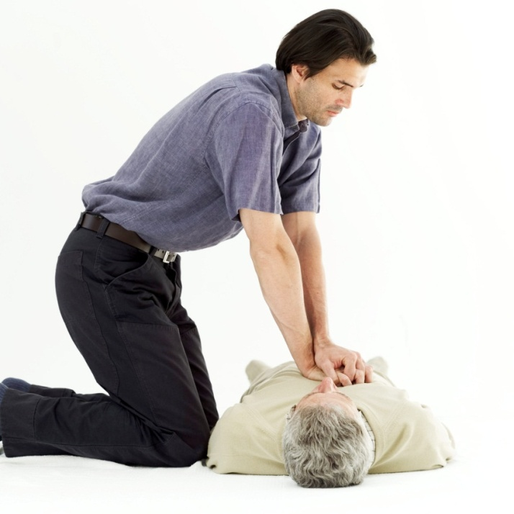
When to perform CPR?
Person is unconscious.
Person is not breathing or not breathing normally (gasping).
Person has no pulse.

Slide 4
Most bystanders are worried that they might do something wrong or make things worse.
Providing Hands-Only CPR to an adult who has collapsed from SCA can more than double that person’s chance of survival.

Slide 5
Hands-Only CPR is CPR without mouth-to-mouth breathing. It is recommended for use by people who see an adult suddenly collapse in an “out-of-the-hospital” setting.

Slide 6
AED
Automated external defibrillator (AED) use also dramatically increases a SCA victim’s chance of survival.
Learning the location of nearby AEDs and how to use them can mean the difference between life or death.

Slide 7
How are you helping?
Chest compressions are essential to maximize the victim’s chance of survival keeping oxygen in the blood circulating throughout the body.

Slide 8
How are you helping?
If chest compressions are not provided to a SCA victim within a few minutes, they will likely die.

Slide 9
How are you helping?
No advanced therapy is more important than chest compressions. Waiting for help to arrive will decrease the chances of survival.

Slide 10
How are you helping?
Using an AED to shock the heart back into rhythm can double the chance of survival.

Slide 11
Three Easy Steps to Save a Life
1. Call 911 for emergency assistance if no response.
2. Start chest compressions immediately.
3. Send someone to find an AED if one is available and use the AED as soon as it arrives.

Slide 12
Call 911
If someone collapses, is not breathing normally, and is unresponsive to shaking.
Avoid moving the victim unless in immediate danger.
Be aware of your location to help rescuers find you.

Slide 13
Start Compressions Immediately
Put person on their back.
Put the heel of your hand on the center of their chest, put your other hand on top of the first.
With arms straight, push down hard and fast, at about 100 pushes a minute.
Keep pushing until additional helps arrives.

Slide 14
Hands Only CPR Video

Slide 15
Points to Remember for Adult CPR
Chest compressions need to be given at a rate of 100 per minute.
Chest compression depth needs to be 2 inches for adults.
Allow chest to return to normal position between compressions.
Continue chest compressions until help arrives.

Slide 16
When to perform CPR?
Person is unconscious.
Person is not breathing or not breathing normally (gasping).
Person has no pulse.
PRACTICE TIME

Slide 17
AED Training Video

Slide 18
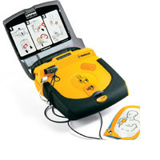
Use the AED as soon as it arrives
If victim is in or near water, move to dry area.
Expose victims chest.
Turn AED power on and follow voice prompts.

Slide 19
Apply AED Pads to Chest Place one pad on upper right chest and one pad on left rib area.

Slide 20
Apply AED Pads to Chest
Make sure connection is good, may need to dry off skin or shave hair.
Remove any medication patch if present.
Remove metal necklaces, underwire bras.
If person has implanted device or piercings, keep pads 1 inch away.

Slide 21
Analyze the Victim’s Heart Rhythm
Press the AED button “analyze”.
No one should be touching victim.
If advised, machine will deliver shock(make sure everyone is clear and not touching victim).
If shock is not advised continue CPR and follow AED voice prompts.

Slide 22
Questions? Please see your school nurse.

